Slide 1

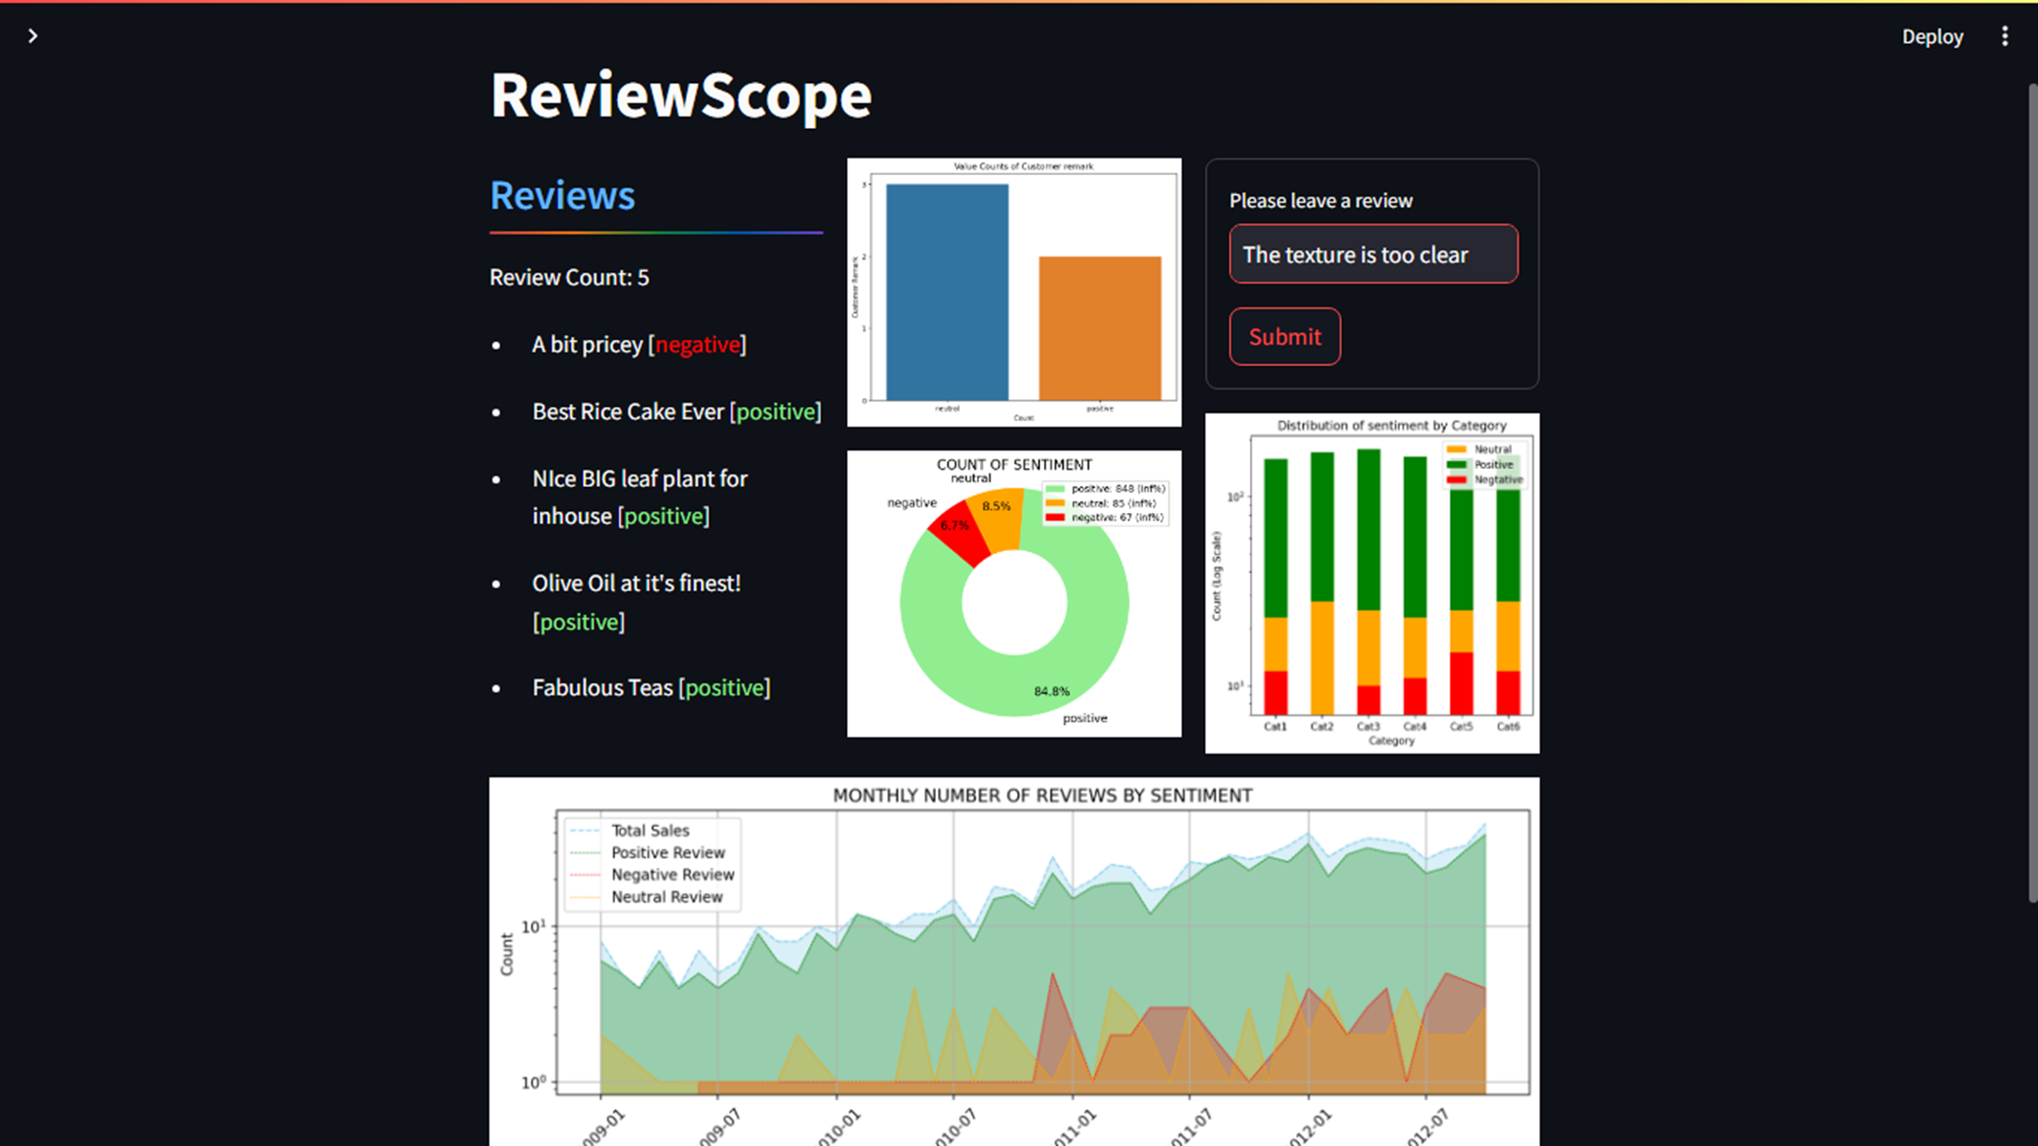
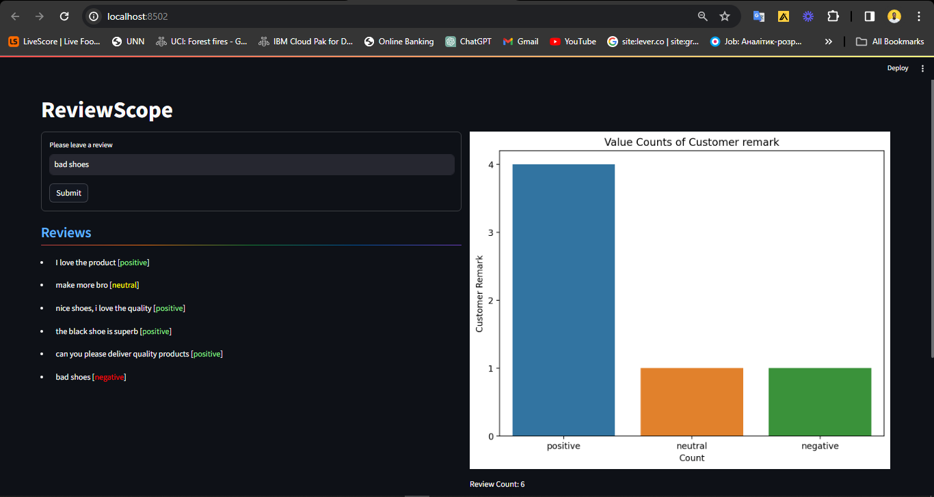
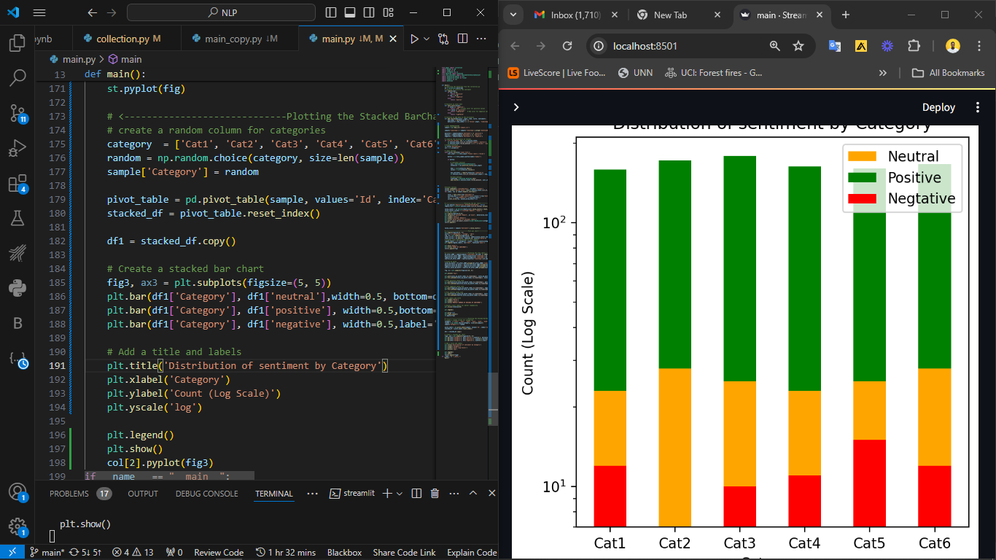


VADERS vs Roberta in Sentiment Analysis
Sentiment analysis is a powerful tool for understanding the emotional context of text. Two popular models, VADER and RoBERTa

Slide 2


VADER:
(Valence Aware Dictionary and sEntiment Reasoner)
Lexicon-based approach
Fast and lightweight
Well-suited for short texts
Easy to understand sentiment scores

Slide 3

VADER is a lexicon-based sentiment analysis tool. It analyzes text by referencing a dictionary of words with assigned sentiment scores.
For example, the word "happy" might have a positive score, while the word "sad" might have a negative score. VADER then analyzes the text and assigns a sentiment score based on the words it finds.
This simplicity makes VADER a good choice for analyzing large volumes of short customer reviews, where a quick overview of sentiment is needed.

Slide 4
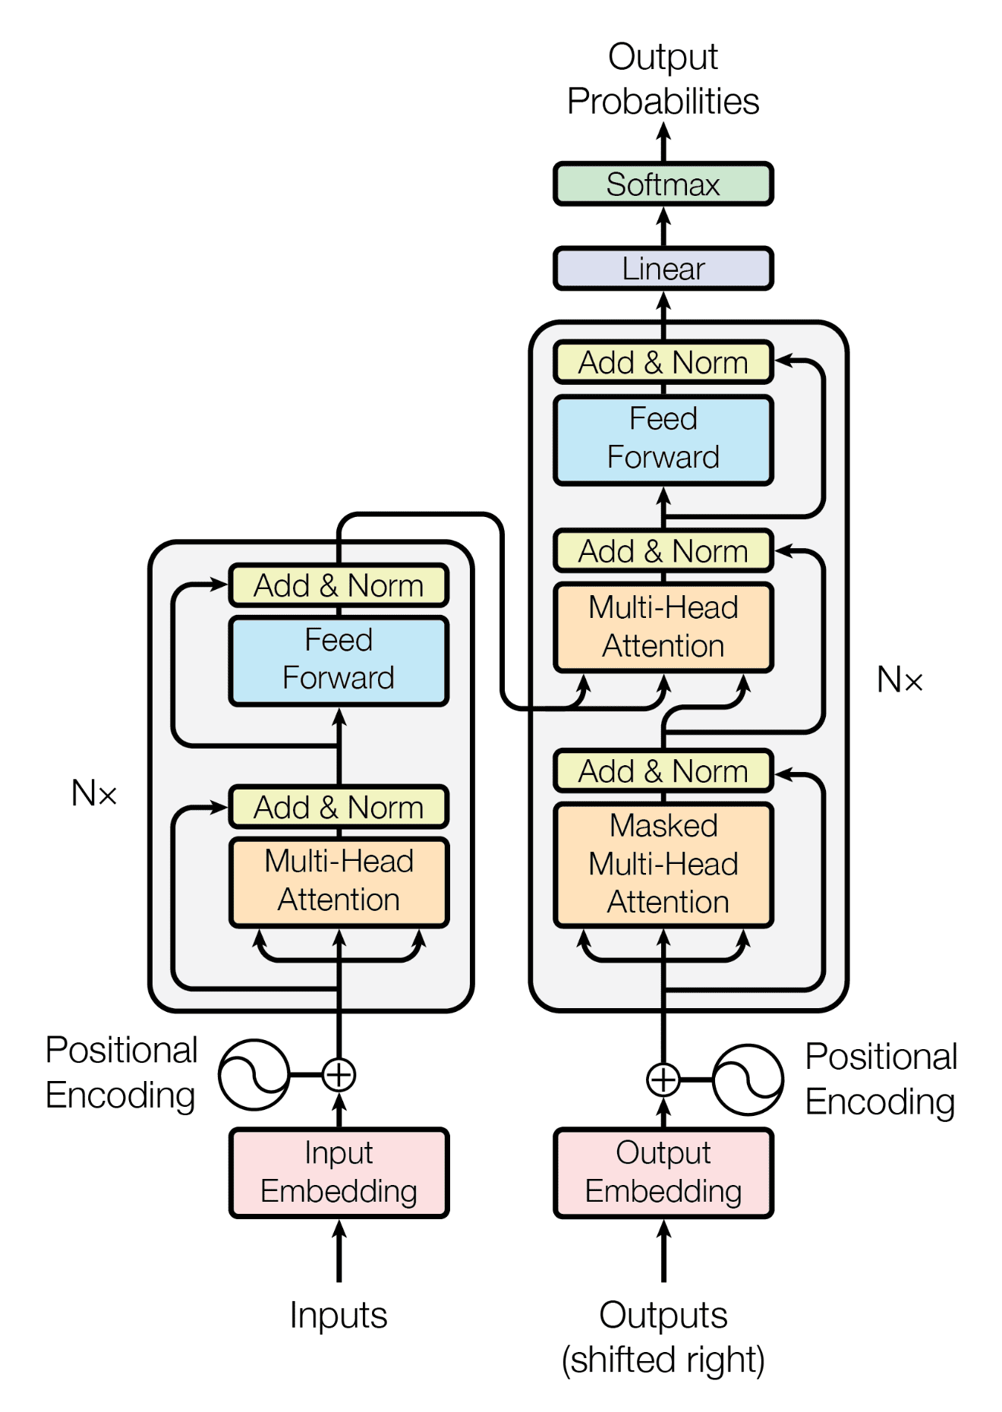
RoBERTa:
(Robustly Optimized BERT Pretraining Approach)
Deep learning approach
More accurate
Understands context and sarcasms better

Slide 5

RoBERTa is a transformer-based deep learning model, an improvement over BERT and is designed to enhance BERT's performance by optimizing its pre-training process.
In developing ReviewScope, we utilize the “cardiffnlp/twitter-roberta-base-sentiment” model from Hugging Face to classify the sentiment of customer reviews on products. The model's weights, obtained through transfer learning, are applied to our use-case dataset to extract sentiment.

Slide 6
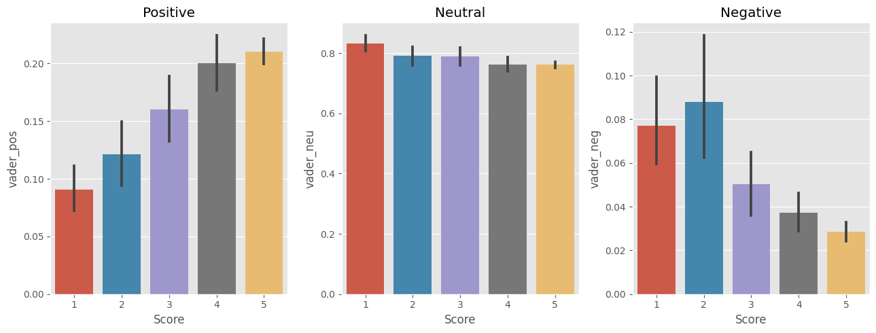
Performance Evaluation

Slide 7
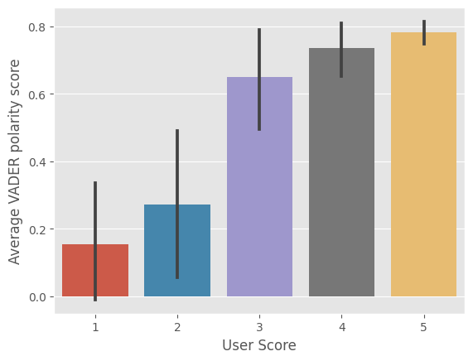
Performance Evaluation
VADER
RoBERTa
The chart above shows the average polarity score by the user sentiment. This implies that the VADER model performs very well generally in classifying the sentiment of the reviews

Slide 8
Conclusion and Recommendations
1
2
3
Choose Wisely
Select the sentiment analysis model that best fits your specific use case and requirements.
Continuous Improvement
Regularly evaluate and fine-tune your sentiment analysis approach to ensure optimal performance.
Explore Hybrid Approaches
Consider combining the strengths of different models to create a more robust solution.

